Slide 1
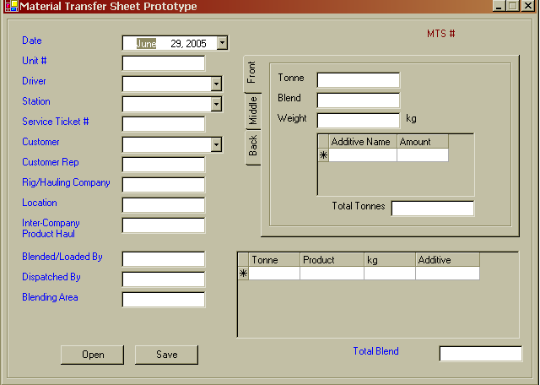
The date the unit will get loaded
We can have multiple units, and drivers
Not needed
The Job LSD
Not needed right now
Inputed by the user from the MTS Book
Not needed

